Slide 1
PSCS224 - Customer Support Chatbot with ML
PIP2001 Capstone Project
VIVA-VOSE
Batch Number: CST G-01
Under the Supervision of,
Dr. Saravanan
Assistant Professor
School of Computer Science and Engineering
Presidency University
Roll Number | Student Name
20211CST0024 | Mohammed Rahim
20211CST0017 | Ronuru Mukesh
20211CST0005 | Saribala Vinay Kumar Reddy
20211CST0016 | Rampalli Jagan Mohan
Name of the Program: Computer Science and Technology(AIML)
Name of the HoD: Dr. Saira Banu
Name of the Program Project Coordinator: Dr. H M MANJULA
Name of the School Project Coordinators: Dr. Sampath A K / Dr. Abdul Khadar A / Mr. Md Ziaur
Rahman

Slide 2
Introduction
In today’s digital world, customer service plays an important role in defining a business's success. With increasing customer expectations for prompt and effective assistance, organizations are under pressure to deliver seamless support experiences. The ability to provide quick, efficient, and personalized customer service has become a critical differentiator for businesses striving to maintain a competitive edge.
This project focuses on developing an intelligent customer support chatbot leveraging machine learning (ML) and natural language processing (NLP). The chatbot is designed to understand user queries, classify intents, and provide accurate, context-aware responses. By incorporating ML models and NLP techniques, the proposed solution aims to enhance user engagement, reduce operational costs, and streamline customer support processes.

Slide 3
LITERATURE SURVEY
1.Brownlee, J. (2021). What is Natural Language Processing? A gentle introduction to NLP. Machine Learning Mastery: Brownlee’s work provides a foundational understanding of Natural Language Processing (NLP), essential for developing a customer support chatbot. The article introduces key concepts such as tokenization, stemming, lemmatization, and sentiment analysis. It explains how NLP enables machines to interpret, process, and generate human language, forming the basis for conversational AI
2.Devlin, J., Chang, M.-W., Lee, K., & Toutanova, K. (2019). BERT: Pre-training of deep bidirectional transformers for language understanding. Proceedings of NAACL-HLT.
The BERT (Bidirectional Encoder Representations from Transformers) model represents a groundbreaking development in NLP, significantly enhancing conversational AI capabilities. Devlin et al. describe BERT’s unique ability to process language bidirectionally, capturing context from both preceding and succeeding words in a sentence. This enables a deeper understanding of nuanced queries, making it ideal for customer support chatbots. The paper details the pre-training and fine-tuning stages of BERT, highlighting its adaptability across diverse NLP tasks. By utilizing BERT, chatbots can deliver more accurate and context-aware responses, improving user satisfaction and support efficiency.

Slide 4
RESEARCH GAPS OF EXISTING METHODS
Rule-Based Chatbots
Rule-based chatbots were the first type of conversational agents used in customer support. These systems follow a static set of pre-programmed responses based on specific keywords or patterns in the user’s input.
Retrieval-Based Models
Retrieval-based models represent a more sophisticated approach to customer support chatbots. These systems rely on a large dataset of potential responses and attempt to select the most relevant one based on the user’s query.
Generative Models
Generative models, unlike retrieval-based systems, generate responses on the fly rather than pulling from a set of predefined responses. These models, which are based on deep learning architectures, such as Recurrent Neural Networks (RNNs), Long Short-Term Memory (LSTM) networks, and Transformers (e.g., GPT, BERT), are capable of producing text that is more dynamic and adaptable to a wide range of queries.

Slide 5
PROPOSED MOTHODOLOGY
The development of a customer support chatbot involves integrating advanced natural language processing (NLP) techniques and machine learning (ML) models to enhance user experience and provide efficient, automated responses. The methodology is divided into several systematic stages to ensure the chatbot meets the desired functionality and performance requirements.
The stages include data collection, preprocessing, model selection, chatbot architecture design, implementation, testing, and deployment
Problem Identification and Requirement Analysis
Data Collection
Data Preprocessing
Intent Recognition and Entity Extraction
Chatbot Architecture Design
Machine Learning Model Training
Chatbot Implementation
Testing and Validation
Deployment

Slide 6
OBJECTIVES
The primary goal of this project is to design and develop a customer support chatbot powered by machine learning to streamline communication between customers and service providers. The specific objectives are outlined below:
Automate Customer Support Processes
Enhance User Experience
Implement Intent Recognition
Enable Context-Aware Conversations
Provide Personalized Interactions

Slide 7
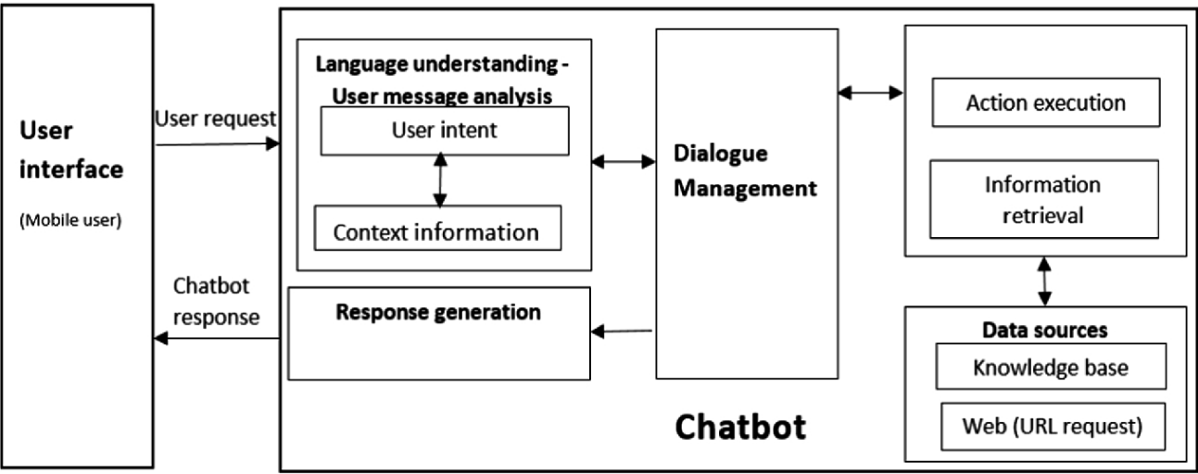
SYSTEM DESIGN & IMPLEMENTATION

Slide 8
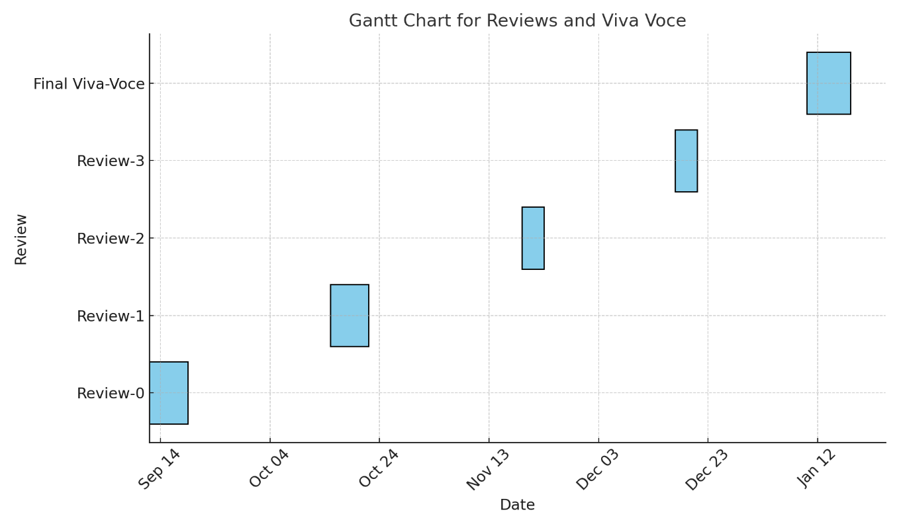
PROJECT TIME LINE

Slide 9
OUTCOMES
Automated Query Resolution
Enhanced Customer Satisfaction
Cost-Effective Solution
Insights Through Data Analysis
Scalability
Learning and Continuous Improvement
Error Reduction
Business Productivity Boost

Slide 10
Conclusion
The "Customer Support Chatbot with ML" project represents a significant step towards leveraging machine learning and AI technologies to enhance customer support in e-commerce platforms. This chatbot was designed to provide users with seamless interaction, offering quick and accurate responses to queries, thereby improving customer satisfaction and operational efficiency for businesses.
Throughout the development process, tools like Dialogflow, Flask, and Bootstrap were employed to achieve a functional and user-friendly chatbot. Dialogflow's robust natural language processing capabilities enabled the chatbot to understand and interpret user queries effectively, while Rasa's integration allowed for custom machine learning models to enhance the chatbot's contextual understanding. Flask served as the backend framework for smooth API communication, and Bootstrap ensured an appealing user interface.
The chatbot successfully meets its objectives by providing real-time assistance, reducing the reliance on human agents for routine queries, and enabling scalability in customer support operations. Although the current version does not incorporate sentiment analysis, the chatbot demonstrates significant potential for future upgrades, such as emotion recognition, multilingual support, and integration with advanced analytics tools.

Slide 11
References (IEEE Paper format)
[1] Brownlee, J. (2021). What is Natural Language Processing? A gentle introduction to NLP. Machine Learning Mastery. Retrieved from https://machinelearningmastery.com/
[2] Devlin, J., Chang, M.-W., Lee, K., & Toutanova, K. (2019). BERT: Pre-training of deep bidirectional transformers for language understanding. Proceedings of NAACL-HLT.
[3] Goodfellow, I., Bengio, Y., & Courville, A. (2016). Deep Learning. MIT Press.
[4] Hugging Face. (2023). Transformers for conversational AI. Retrieved from https://huggingface.co/
[5] IBM. (2022). The role of chatbots in customer service. IBM Watson Blog. Retrieved from https://www.ibm.com/blogs/watson/
[6] Microsoft Azure. (2023). Azure Cognitive Services for chatbots. Retrieved from https://azure.microsoft.com/en-us/
[7] OpenAI. (2023). Technical report on GPT advancements in natural language understanding. Retrieved from https://openai.com/research/
[8] Pandey, V., & Pandey, A. (2020). Role of AI and Machine Learning in customer service chatbots. International Journal of Research in Engineering and Technology, 9(3), 45-50.
[9] Radziwill, N. M., & Benton, M. C. (2017). Evaluating quality of chatbots and intelligent conversational agents. Journal of Quality Management, 25(2), 215-235.
[10] Serban, I. V., Sordoni, A., Bengio, Y., Courville, A., & Pineau, J. (2016). Building end-to-end dialogue systems using generative hierarchical neural network models. Proceedings of the AAAI Conference on Artificial Intelligence.
[11] Lei Cui., Shaohan Huang., Furu Wei., Chuanqi Tan., Chaoqun Duan., and Ming Zhou., SuperAgent: A Customer Service Chatbot for E-commerce Websites (2017), cited by 493

Slide 12
Publication Details
International Journal for Multidisciplinary Research (IJFMR)
Link: https://doi.org/g8w2zq

Slide 13


